Slide 1
Android layouts and Views

Slide 2
What is Layout ?
A well-designed UI enhances user engagement, improves usability, and creates a positive impression of your app
Layouts are predominantly constructed through XML files, residing in the "res/layout" directory, to articulate the arrangement and appearance of UI elements.
XML layouts provide a declarative way to define the structure, appearance, and behavior of UI elements.

Slide 3
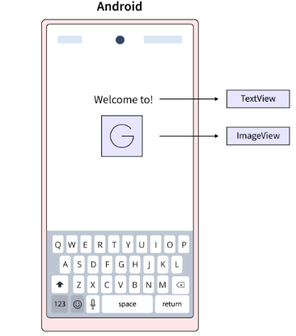
What is a View ?
A View serves as the user interface responsible for creating interactive UI elements like TextView, ImageView, EditText, RadioButton, etc.
It handles event interactions and drawing tasks, commonly referred to as Widgets.

Slide 4
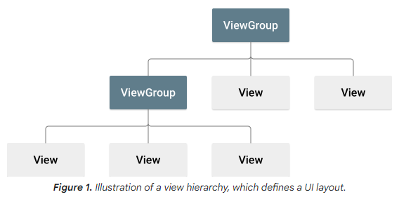
View and View Group
A ViewGroup however is a subclass of View, functions as an invisible container holding other Views or ViewGroups while defining their layout properties.
The elements in a layout are constructed using a hierarchy of View and ViewGroup objects.

Slide 5
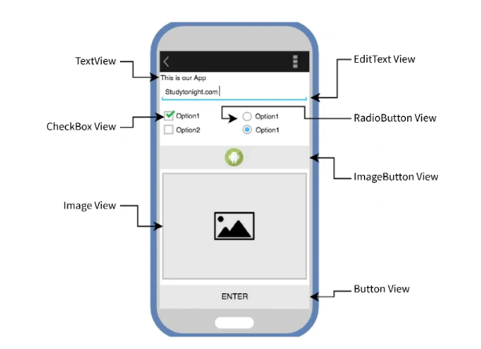
Contd.

Slide 6
XML Layouts
XML stands for eXtensible Markup Language, and it is a markup language that defines hierarchical data structures
In Android, XML layouts are used to define the structure and appearance of UI elements.
XML provides a clear separation between the UI and the app’s logic, making it easier to maintain and modify the UI independently.

Slide 7
Types of Layouts
Linear Layout
Relative Layout
Constraint Layout
Frame Layout
Table Layout

Slide 8
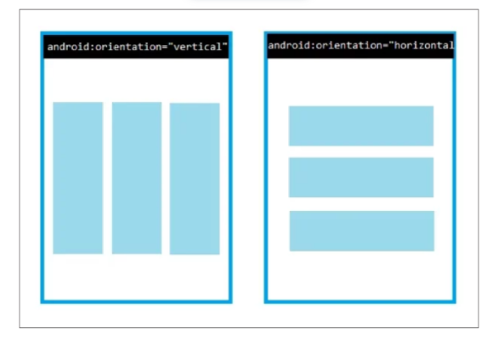
Linear Layout
Is a View Group subclass, used to provide child View elements one by one either in a particular direction either horizontally or vertically based on the orientation property.

Slide 9
Linear Layout - attributes
layout_weight - divides the remaining space amongst the views
weightSum - total weight sum
Orientation - horizontal or vertical.
Gravity - position its content on its X and Y axes(center_vertical, fill, center, bottom, end)
layout_gravity - gravity of the View or Layout relative to its parent(center_vertical, fill, center, bottom, end)
Id - This gives a unique id to the layout.

Slide 10
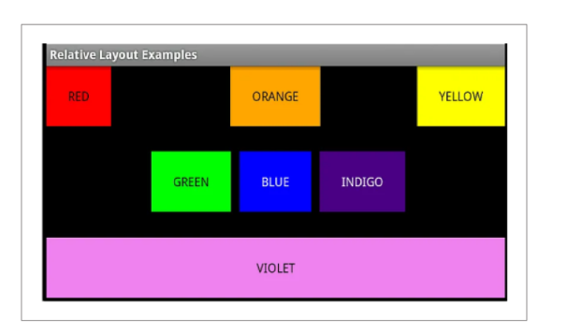
Relative Layout
Is a View Group subclass, used to specify the position of child View elements relative to each other like (A to the right of B) or relative to the parent (fix to the top of the parent).

Slide 11
Relative layout - attributes
layout_alignLeft
layout_alignRight
layout_alignStart
layout_alignEnd
layout_toLeftOf
layout_toRightOf
layout_toStartOf
layout_toEndOf
layout_above
layout_below
layout_alignParentLeft
layout_alignParentRight
layout_alignParentTop
layout_alignParentBottom
layout_centerInParent
layout_centerHorizontal
layout_centerVertical
Sibling ViewID
True

Slide 12
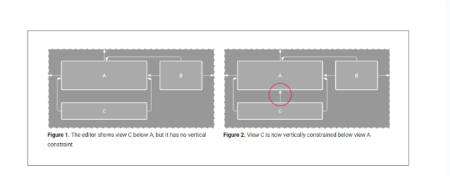
Constraint Layout
Is a View Group subclass, used to specify the position of layout constraints for every child View relative to other views present.
A Constraint Layout is similar to a Relative Layout, while offers enhanced capabilities.

Slide 13
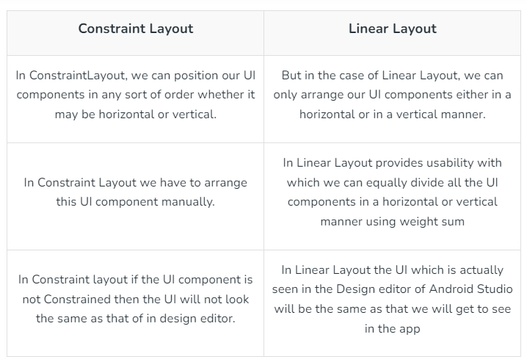
Constraint vs Linear

Slide 14
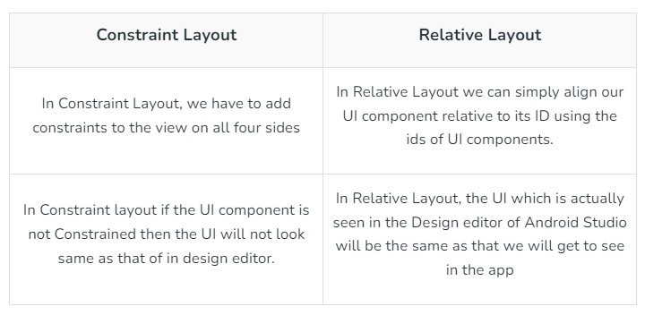
Constraint vs Relative

Slide 15
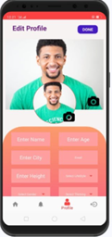
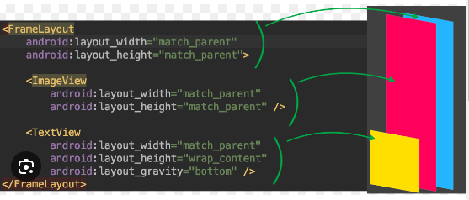
Frame Layout
Is a View Group subclass, used to specify the position of View elements it contains on the top of each other to display only a single View inside the Frame Layout.

Slide 16
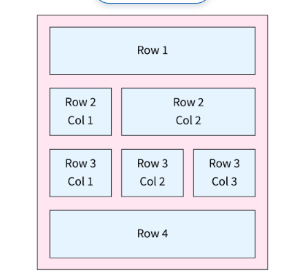
Table Layout
Is a View Group subclass, used to display the child View elements in rows and columns.

Slide 17
Types of Views
View is simple block of a UI
List View
Grid View
Web View
Scroll View

Slide 18
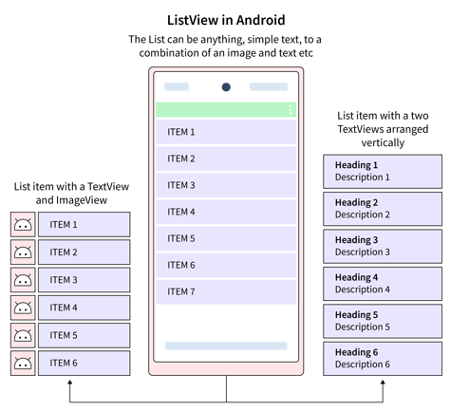
List View
Is a View Group, used to display scrollable lists of items in a single column.

Slide 19
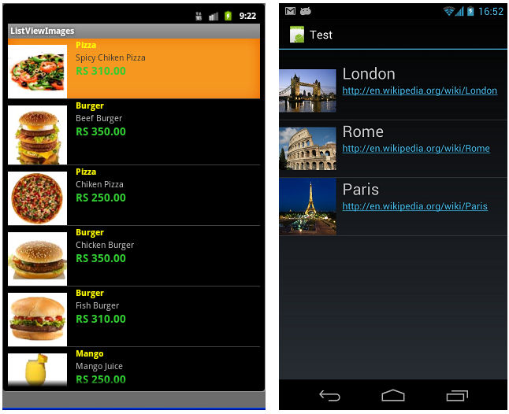
Contd..

Slide 20
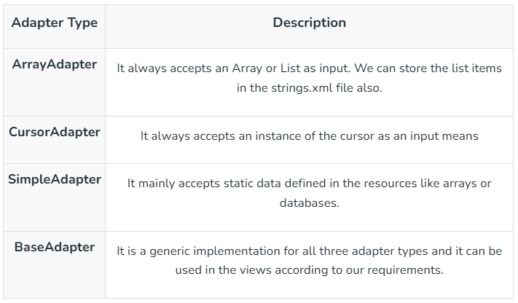
Imports for list view

Slide 21
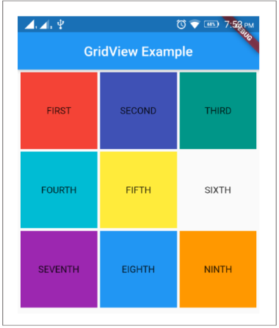
Grid View
The Grid View serves as a user interface component specifically crafted to exhibit data in a scrollable grid format with a distinctive two-dimensional structure to organize items seamlessly across both rows and columns.

Slide 22

Web View
Is a browser that is used to display the web pages in our activity layout.
This feature proves beneficial for diverse purposes, including presenting websites, loading HTML content, or even constructing a basic web browser interface within your application

Slide 23
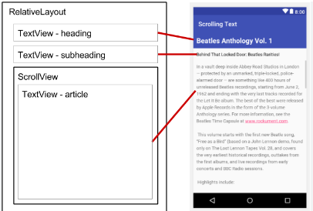
Scroll View
Scroll View can contain only one direct child.
Consequently, for layouts with multiple view controls, they must be enclosed within another standard layout such as Linear Layout, Table Layout, or Relative Layout.

